Slide 1



CP2
KREATIVE GENESIS 2026
FILE ANALYZER
PROBLEM STATEMENT TITLE : Cyber Safety Awareness & Phishing Detection Platform
DOMAIN NAME: Women’s Safety & Social Security
PROBLEM STATEMENT :A user-friendly tool that scans suspicious files (APKs, Doc’s, Video’s, Image’s, audio’s and etc ) to detect malware and phishing attempts. Built for all, especially first-time internet users and those less familiar with technology and technology user’s too.
TEAM-ID : KGH161
TEAM NAME : RAVANA SENTINELS

Slide 2

CP2
PROBLEM STATEMENT
Problem Overview
Brief description of the problem being addressed With the rapid increase in smartphone and internet usage across India, cyber crimes have become a daily threat—especially those using malicious files like fake APKs, PDFs, and phishing links. Scammers trick users through:
Fraudulent messages claiming "viral MMS videos" (like the Angel Nuzhat scam)
Fake banking apps sent via WhatsApp to steal OTPs and UPI pins
Digital arrest threats with forged documents in PDF format
Malicious links disguised as government schemes or utility bill payment alerts
Most users are unaware of these tactics and unknowingly compromise their personal data and life savings. There is a urgent need for a simple, accessible tool that can help people verify suspicious links and files before it's too late.
Target users or beneficiaries

Slide 3
CP2
PROBLEM STATEMENT
Target users or beneficiaries
User Group | Why They Need This
Women & Senior Citizens | Most targeted by emotional manipulation and fake video scams; often less familiar with technical safety measures
First-time Internet Users | Vulnerable to phishing links and fake APKs due to lack of awareness
Students & Young Adults | Active on social media and exposed to viral scam links daily
Small Business Owners | Receive fraudulent payment links and fake order PDFs
General Public | Anyone with a smartphone and UPI/banking apps is at risk

Slide 4
CP2
PROBLEM STATEMENT
Solution Overview
Short explanation of the proposed solution: The File Analyzer Application is an Android-based security system that scans and analyzes different types of files such as images, videos, documents, APKs, and audio files. The system uses an automated scan engine with static analysis to detect suspicious patterns and classify files as Safe or Malicious. A backend monitoring agent continuously observes the scanning process and sends notifications to users when threats are detected. Scan results are stored in Local History, and highly suspicious files can be forwarded to an external analysis server for deeper inspection
Key features or capabilities of the system
• Multi-format file analysis – Scans images, videos, documents, APK files, and audio files.
• Automatic scan engine – Automatically analyzes uploaded files using static analysis techniques.
• Threat detection – Classifies files as Safe or Malicious based on detected patterns.
• Backend monitoring agent – Continuously monitors scans and sends security notifications to the user.
• Secure result management – Stores scan results in local history and forwards suspicious files for deeper analysis

Slide 5
CP2
PROBLEM STATEMENT
Prototype Overview
Explanation of the current prototype Our prototype is an Android application that analyzes different types of files such as images, audio, video, documents, and APK files. The app scans the selected file and checks for potential threats. After the analysis, it classifies the file as Safe, Suspicious, or Malicious to help users avoid cyber threats.
Implemented Components
1. Application Interface
Simple Android UI built using Kotlin and Java.
Users can upload or select files from their device.
Displays analysis results as Safe / Suspicious / Malicious.
2. Hardware Setup
Runs on Android smartphones.

Slide 6
CP2
PROBLEM STATEMENT
Prototype Overview
Uses the device storage to access and scan files.
3. Circuit Design
Not applicable as the project is software-based.
The system architecture focuses on software modules and file processing.
4. System Modules
File Upload Module – Allows users to select files from the device.
File ScannerModule – Performs analysis on image, audio, video, document, and APK files.
Threat Detection Module – Checks patterns and identifies suspicious content.
Result Display Module – Shows whether the file is Safe, Suspicious, or Malicious

Slide 7
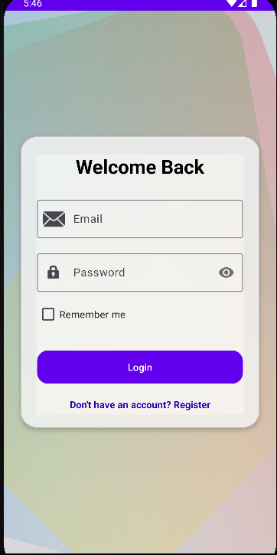
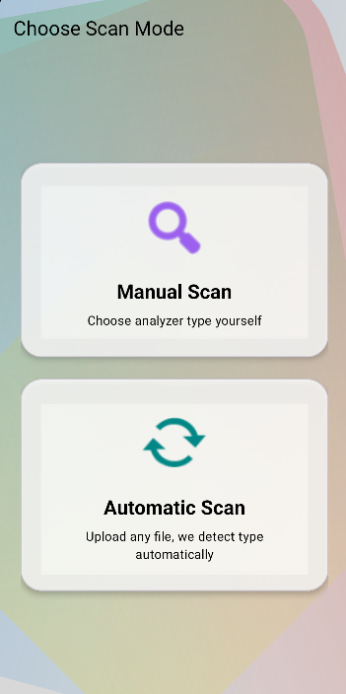
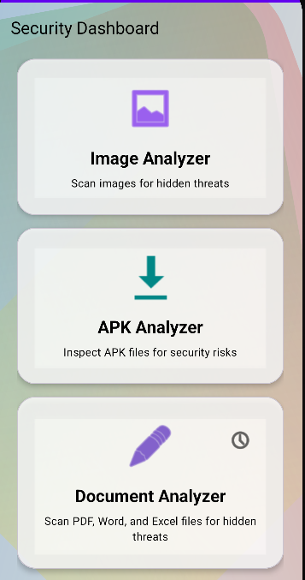
CP2
PROBLEM STATEMENT
Prototype Demonstration
Show the current progress of the project.

Slide 8
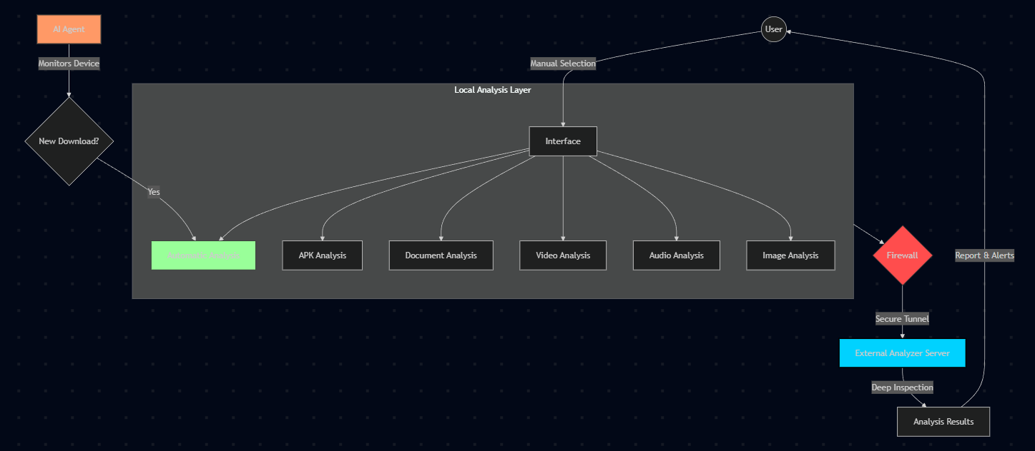
CP2
PROBLEM STATEMENT
System Workflow

Slide 9
CP2
PROBLEM STATEMENT
Progress So Far
Briefly explain what has been completed since the first checkpoint & final checkpoint. 1. Prototype UI Development
The first phase of the project focused on designing the user interface prototype of the File Analyzer application. The prototype includes several key screens such as:
Login Screen – Allows users to securely log in using email and password.
Scan Mode Selection Screen – Users can choose between Manual Scan and Automatic Scan.
Security Dashboard – Displays different analyzers such as:
Image Analyzer
APK Analyzer
Document Analyzer
Video Analyzer
Music Analyzer
Scan Center Screen – Provides options for Manual Scan, Automatic Scan Agent, scan history, and system cleaning features.

Slide 10
CP2
PROBLEM STATEMENT
These screens were created to simulate how users will interact with the system before the actual implementation.
2. Application Workflow Design
The workflow of the application has been planned and designed, including:
User authentication and login system
File scanning options (manual and automatic)
Analyzer modules for different file types
Security dashboard for easy navigation
This helps define how the application will function once the backend is implemented.
3. Analyzer Concept Design
The conceptual design of different file analyzers has been prepared. Each analyzer will inspect specific file types:
Image Analyzer – detects hidden metadata threats
APK Analyzer – checks permissions and malicious code

Slide 11
CP2
PROBLEM STATEMENT
Document Analyzer – scans PDFs and Office files for macros
Video Analyzer – inspects metadata and file structure
Music Analyzer – detects embedded malicious data
These modules will form the core security functionality of the system.
4. Future Implementation Plan
After completing the prototype design, the next development phases will include:
Building the scanning agent to automatically monitor downloaded files.
Developing the backend server to process suspicious files.
Integrating an AI-based analysis system to detect advanced threats.
Implementing the automatic scan agent that runs in the background.
Adding multi-language support to allow users to change the app language.

Slide 12
CP2
PROBLEM STATEMENT
5. Next Development Phase
The upcoming phase will focus on:
Backend development
Agent-based automatic scanning
AI threat detection integration
Server communication for deep analysis
Language selection feature

Slide 13
CP2
PROBLEM STATEMENT
Comparison with File Analyzer
Name of the System | Technologies or Algorithms used | Features | Drawbacks
VIRUS TOTAL | Cloud-based malware scanning, Signature-based detection, Hash comparison | Scans files using multiple antivirus engines, URL scanning, Malware report generation | Requires internet, No offline scanning, Limited mobile integration
GOOGLE PLAY PROTECT | Machine Learning, Behavioral Analysis | Scans installed apps, Automatic threat detection, Real-time protection | Works mainly for Play Store apps, Limited control for user
CUCKOO SANDBOX | Dynamic Analysis, Virtual Machine Monitoring | Executes suspicious files in isolated environment, Behavioral tracking | Complex setup, High system resource usage
MOBILE ANTIVIRUS APP(E.G AVAST) | Signature-based detection, Heuristic Analysis | Real-time protection, App scanning, Web protection | Paid features, Ads in free version, High battery usage
STATIC APK ANALYZER TOOLS | Manifest Analysis, Permission Analysis, Reverse Engineering | Analyzes APK permissions, Detects suspicious API calls | No real-time user warning, Technical knowledge required

Slide 14
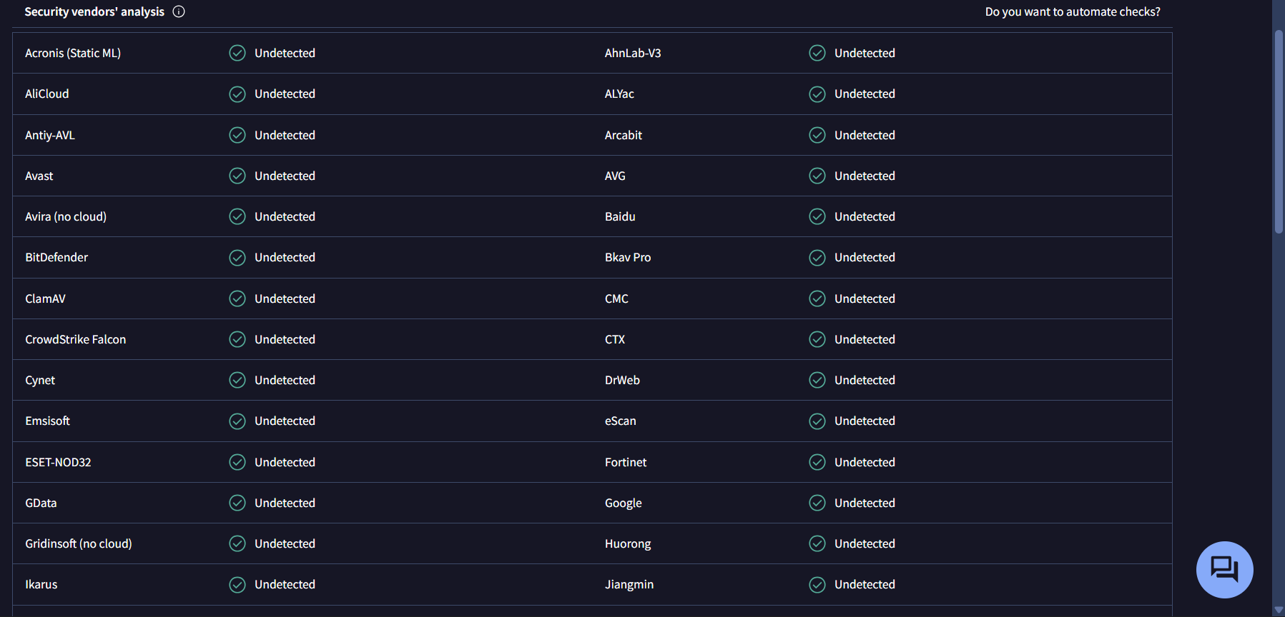
CP2
PROBLEM STATEMENT
VIRUSTOTAL Sample

